Slide 1



FedDL: Dynamic Layer-wise Federated Learning for Human Activity Recognition
Linlin Tu¹, Xiaomin Ouyang², Jiayu Zhou¹,
Yuze He², and Guoliang Xing²
¹Michigan State University, ²The Chinese University of Hong Kong

Slide 2
Human Activity Recognition (HAR)
Smart home, smart health:
Continuous and long-term monitoring of daily activities
Multi-dimensional sensing data (deep learning)
Privacy-sensitive data

Slide 3



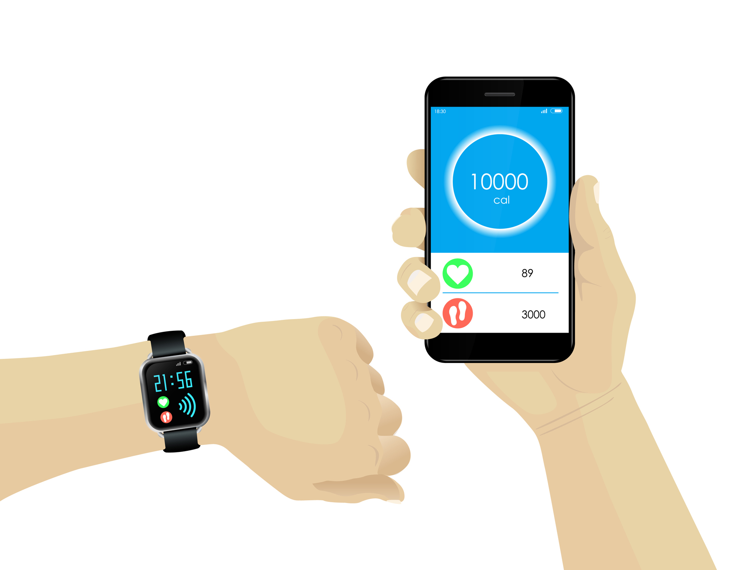

HAR: Current Solutions
Centralized Learning
Significant privacy concern (share raw data).
Server
How about store the data locally?

Slide 4
Federated Learning (FL)
- Enables collaboratively training models while keeping the data residing on devices.
Server
New global model
Not accurate for all users [1][2].
Significant communication overhead.
Model update
[1] Kairouz, Peter, et al. "Advances and open problems in federated learning." arXiv preprint arXiv:1912.04977 (2019).
[2] Yu, Tao, Eugene Bagdasaryan, and Vitaly Shmatikov. "Salvaging federated learning by local adaptation." arXiv preprint arXiv:2002.04758 (2020).

Slide 5


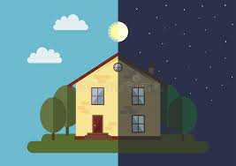
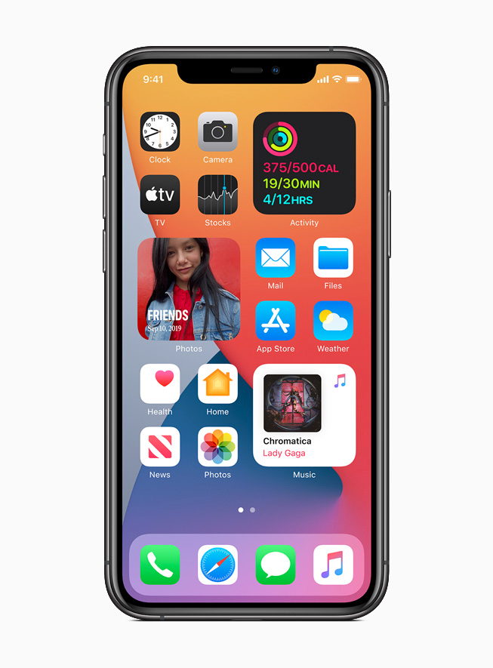
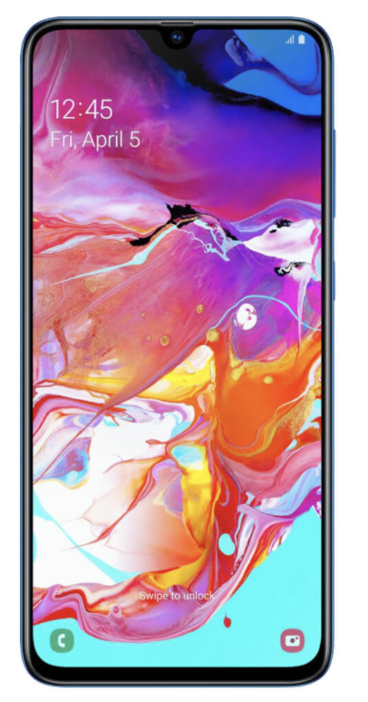
New Insight
There exhibits intrinsic similarities among users’ activity data.
Biological features
Physical environments
Sensor bias
Learn the underlying relatedness among users (clustering) and apply it to model aggregation.
[3] Xiaomin Ouyang, et al. 2021. ClusterFL: a similarity-aware federated learning system for human activity recognition. In Proceedings of the 19th Annual International Conference on Mobile Systems, Applications, and Services. 54–66.

Slide 6
New Insight
The degree of similarity among users’ deep models reduces from the bottom up.
Exploit such similarity of models and aggregate them in an iterative, layer-wise manner.
[4] Lili Mou, et al. 2016.How transferable are neural networks in nlp applications? arXiv preprintarXiv:1603.06111(2016).
[5] Jason Yosinski, et al. 2014. How transfer-able are features in deep neural networks?. In Advances in neural information processing systems. 3320–3328.

Slide 7
HAR Case Study
Initial study results:
HARBOX datasets (IMU)
6 users (randomly selected)
clustering results on local models: (n1,n2), (n3,n4,n5,n6)
accuracy improvement
All sharing | Layer-wise sharing
84.48% | 96.89%
Correlation matrix of 6 users’ HAR data.

Slide 8
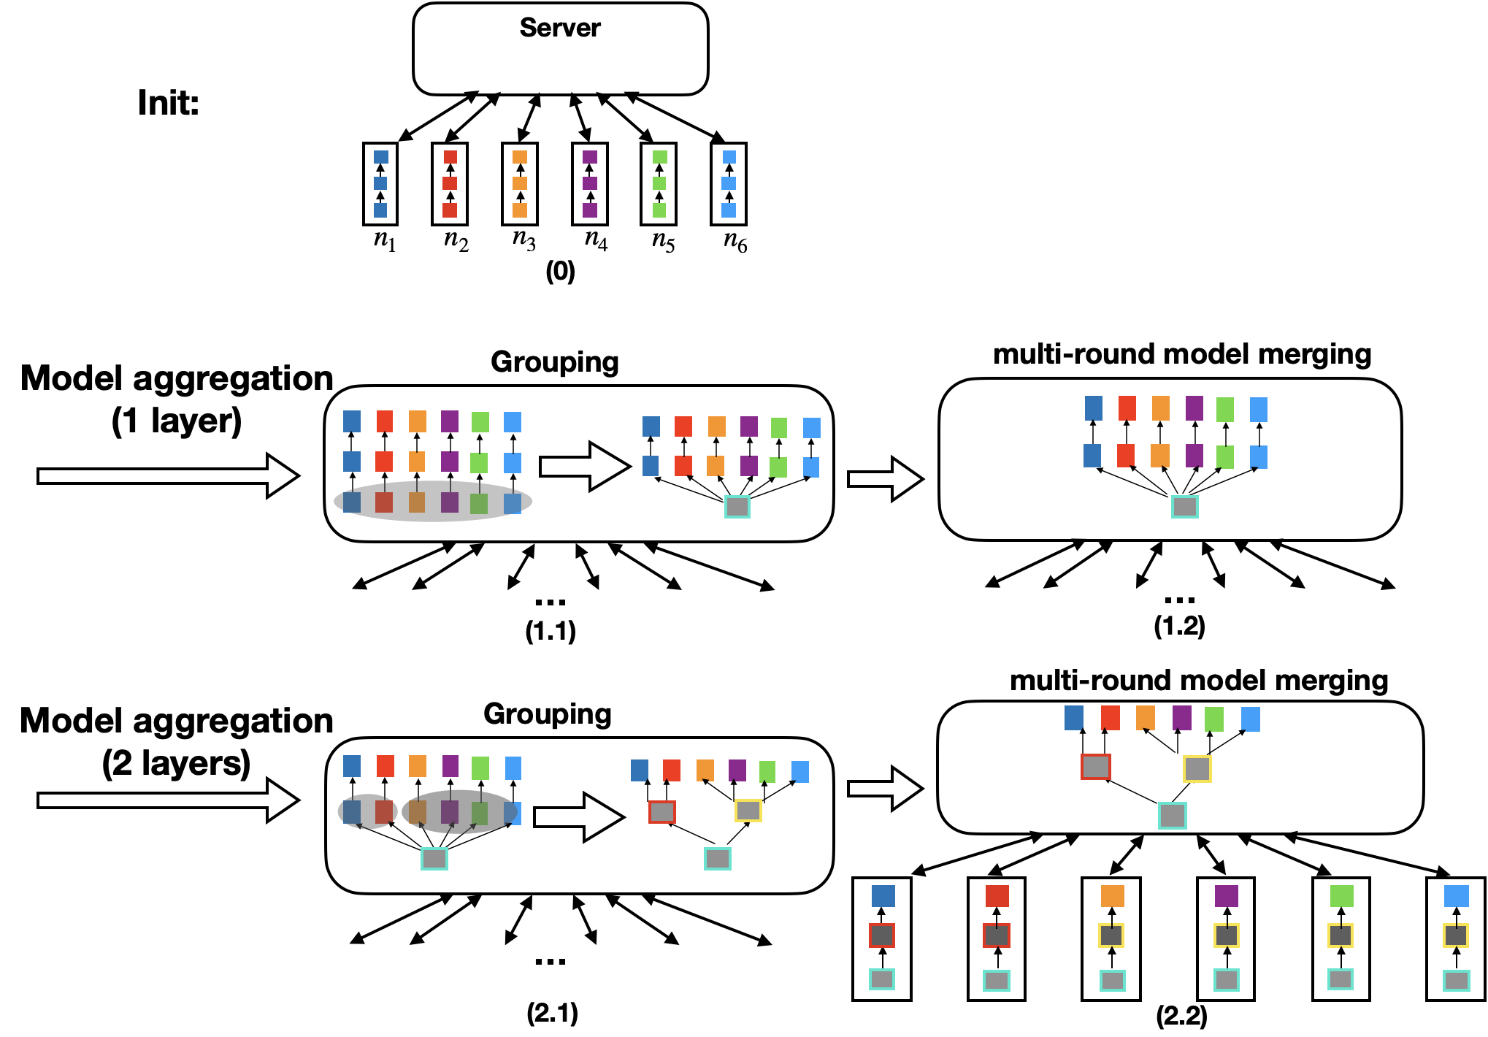
FedDL: Dynamic Layer-wise Federated Learning for HAR
Overview:
Grouping and merging models in a bottom-up layer-wise manner.

Slide 9
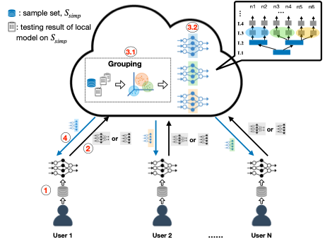
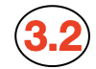
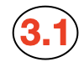



Dynamic Layer-wise FL Framework
R-round local training
Upload local models to the server
At server:
3.1 Grouping (periodical)
3.2 Model merging
Send cloud models to users

Slide 10
Model Affinity based User Grouping
Directly analyzing the weight matrices (l1/l2-norm-based weight distance) has limitations
Permutable neurons
Computational-inefficient
Model affinities measurement based on Kullback–Leibler divergence (KLD):
test all local models on a common sample set
measure the KLD of the different model outputs

Slide 11
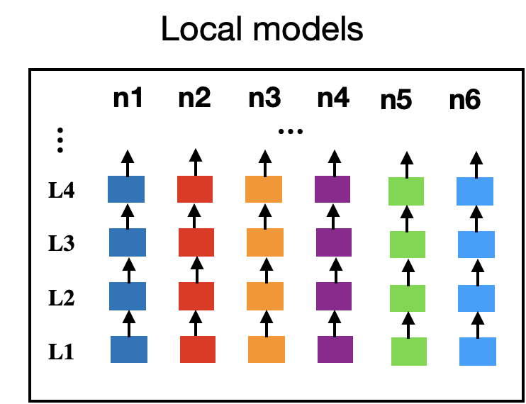
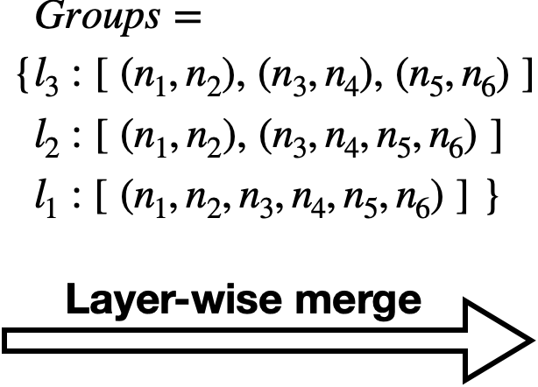
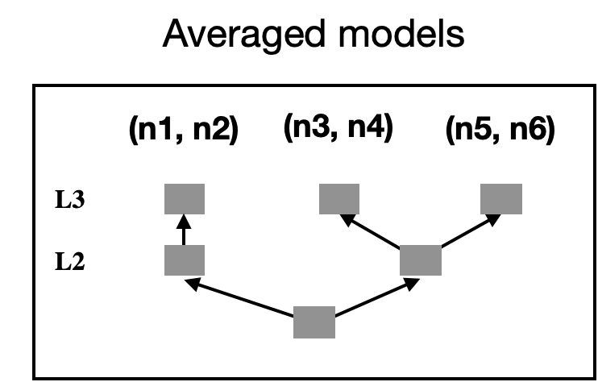
Intra-group Layer-wise Model Merging
Layer-wise model-merge based on grouping results:

Slide 12
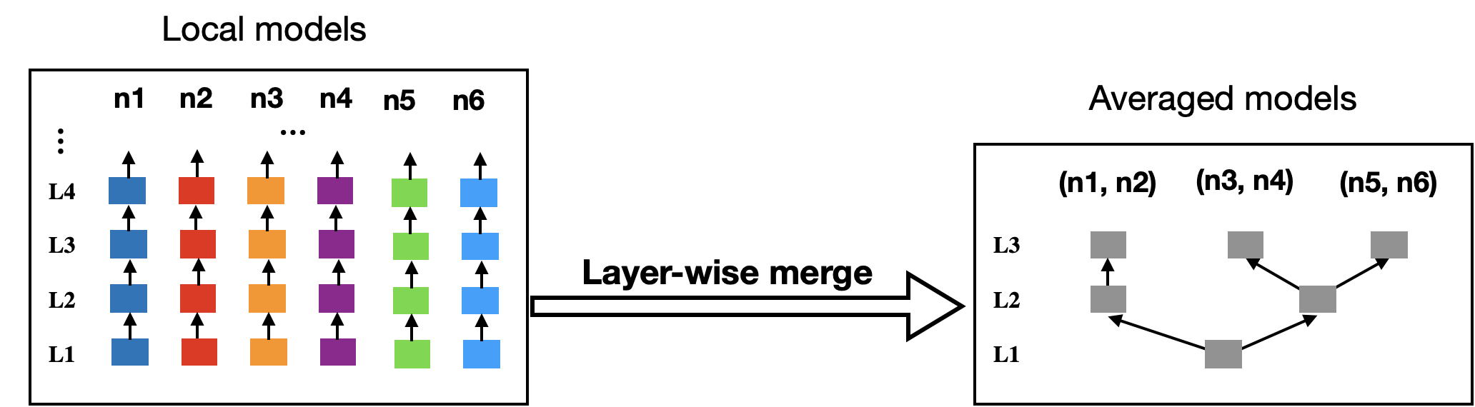
Communication-efficient Design
Reduce the number of parameters that each user uploaded to cloud.
Upload only the lower layers of local models.
Communication between users and the server
Reduce the number of global training rounds.
FedDL converges fast even with a small number of local training rounds

Slide 13
Experiment Setup
Five HAR datasets collected from total 178 users:
Application | Tasks | Sensor | Data Dimension | Number of subjects | Number of records per subject
Human movement detection | with/without human movement | UWB | 50x1 | 8 | ~ 80
Hand Gesture Recognition | good/ok/victory/stop/fist | Depth camera | 36x36x1 | 9 | ~ 400
Activity of Daily Life (ADL) recognition using IMU | walking/hopping/phone calls/waving/typing | IMU | 100x9x1 | 121 | ~ 300
Human Activity Recognition using IMU | walking-upstairs/ walking-downstair/ walking/sitting /standing/laying | IMU | 128x3x2 | 30 | ~ 300
Human Activity Recognition using LiDAR | walking/bending/phone calls/sitting/standing/ checking watch | LiDAR | 60x30x1 | 10 | ~ 600

Slide 14
Experiment Setup
Implementation :
Baselines :
Amazon Elastic Compute Cloud (Amazon EC2), with 96 virtual CPUs (3.1 GHz) and 768 GB memory.
Run each user end on one CPU to simulate the federated learning.
socket programming for client-server communication.
learning system: Tensorflow, sklearn, numpy
CNN (2 conv, 2 fc, 1 output); mini-batch SGD;
FedAvg (Federated Averaging)
FedPer (FL with lower layers shared)
pFedMe (Federated Transfer Learning)
Local training

Slide 15
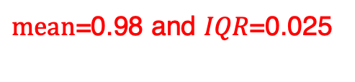
Evaluation: Validation on LiDAR dataset
$mean$=0.98 and 𝐼𝑄𝑅=0.025
On LiDAR dataset:
Outperform other learning paradigms in accuracy.
Saves about 42.6% communication overhead compared with FedAvg and pFedMe.

Slide 16
Evaluation: Different Datasets
On UWB, Depth images and two IMU datasets:
Outperform several learning paradigms in overall accuracy.
Maintain a relatively low communication overhead.

Slide 17
Evaluation: Scalability
With the number of nodes increasing:
Improve model accuracy for most nodes.
Maintains a relatively low communication overhead

Slide 18
Evaluation: Impact of Local Computation Rounds
With the number of local training rounds (R) increasing:
A Large number of local training rounds improves the convergency in general.
Converge fast even with a small number of local computation rounds.

Slide 19
Conclusion
FedDL: A dynamic layer-wise federated learning system for human activity recognition.
Captures the similarity of users’ models and generates personalized user models through dynamic layer sharing in an iterative layer-wise manner.
Optimizes the communication overhead.
Future work
The trade-off between privacy and utility for correlated users in FL.
Extend FedDL to a wider range of applications.

Slide 20

Thanks!
FedDL: Dynamic Layer-wise Federated Learning for Human Activity Recognition
Linlin Tu, Xiaomin Ouyang, Jiayu Zhou, Yuze He, and Guoliang Xing
http://aiot.ie.cuhk.edu.hk
visit CUHK AIoT Lab

